Slide 1
Google Analytics

Slide 2
AGenda
Overview of Google Analytics Basics
Overview of GA Dashboards
Difference between GA & Google Tag Manager
Development
Adding Code to Websites
Configuring Google Tag Manager
Toolbox tools
In-map tools
NEW: Data-qa

Slide 3
Google Analytics Basics
Web Behavior & Traffic Analytics (1 of many: https://www.invespcro.com/blog/top-15-site-analytics-tools-to-help-optimize-your-site/)
Code put in each page to be monitored
Sends Info back to GA servers
Simple overview: https://www.youtube.com/watch?v=mPgAug15bcQ
Key Reports (maybe?) for using when Our App used externally: https://searchengineland.com/7-essential-google-analytics-reports-every-marketer-must-know-250412

Slide 4
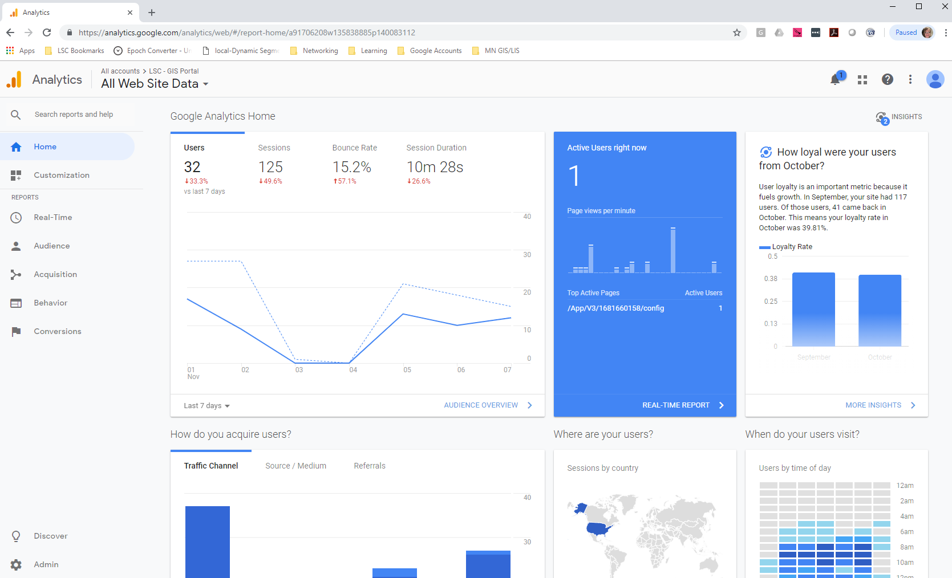
Main GA Page
Notes:
See Statistics, Site Content

Slide 5
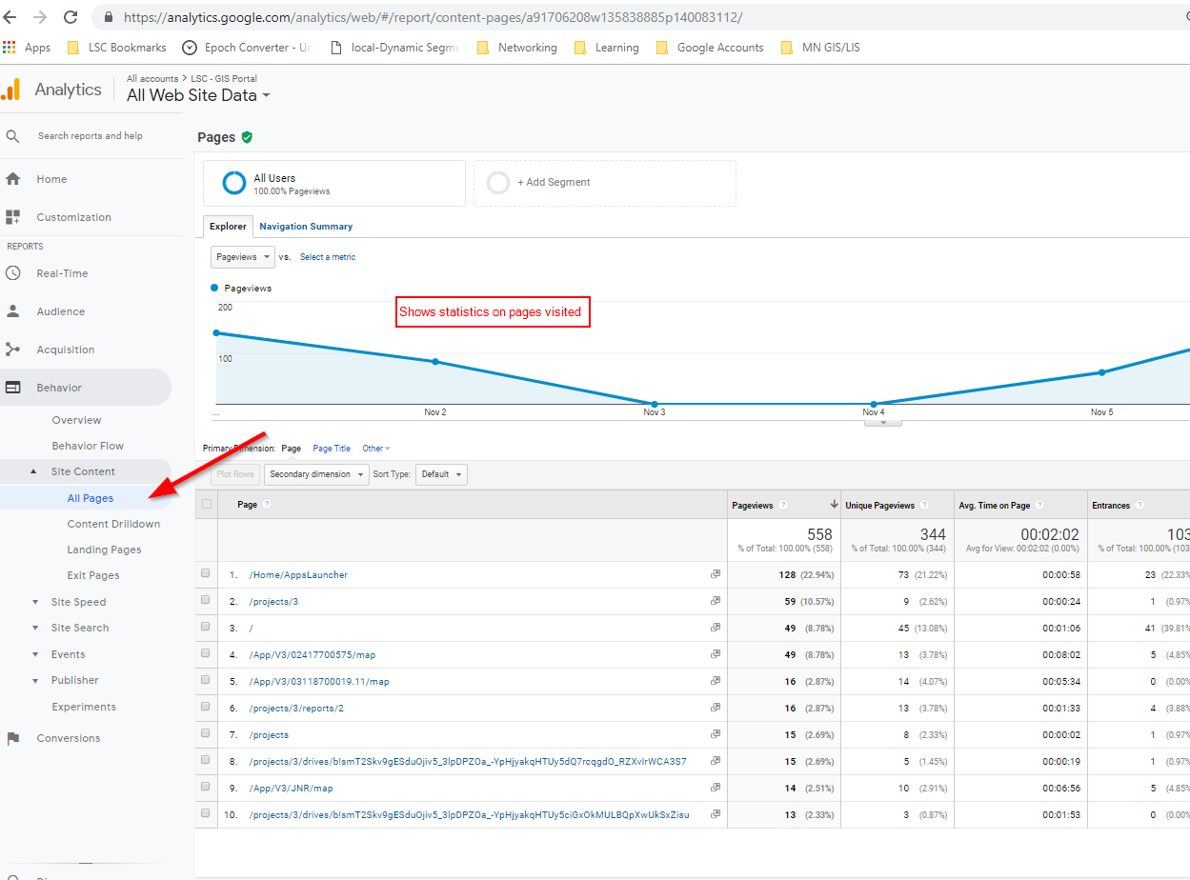
Site Content visits
Notes:
See to export out data

Slide 6
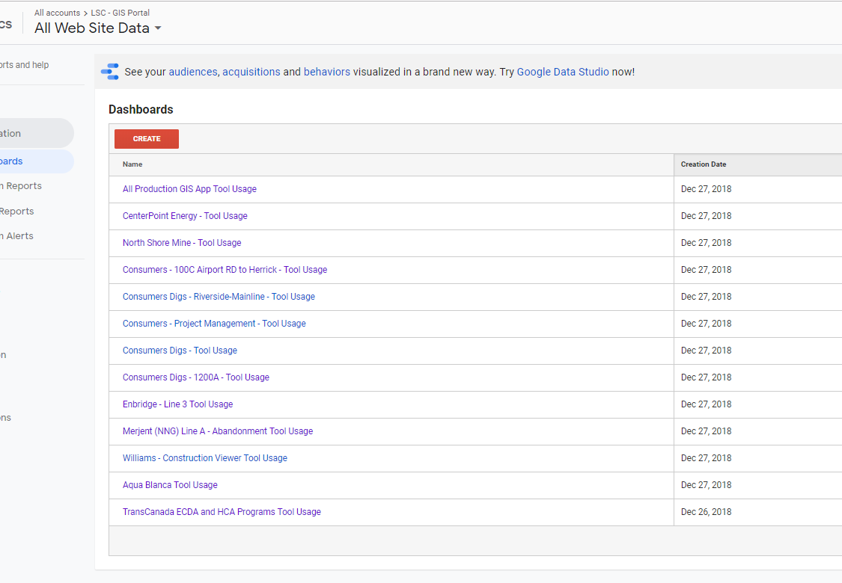
Dashboards
Configured per webpage with filters
https://analytics.google.com/analytics/web/?authuser=1#/a91706208w135838885p140083112/report/dashboard

Slide 7
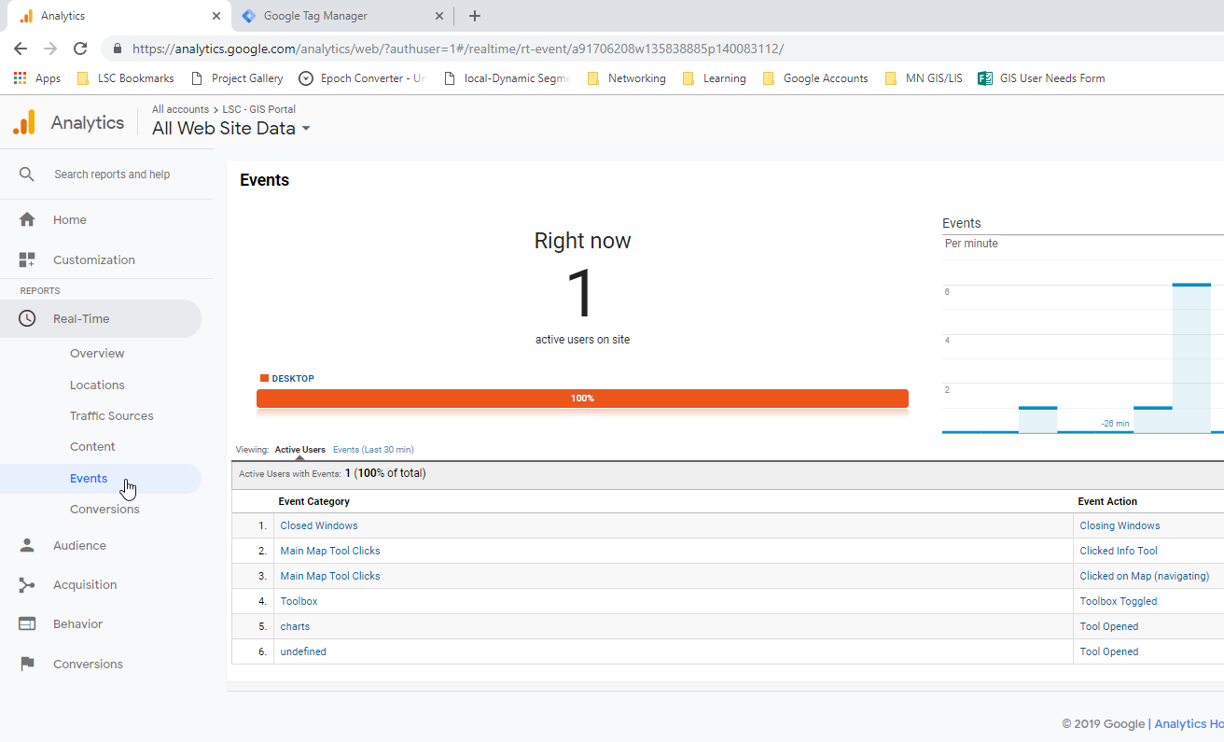
Configuring Tracking Workflow
G Tag Manager:
Turn on default Variables/Data Layers from Google
Set Custom variables to capture click classes/element/text from user
Set Trigger to fire event and send data to a Tag (click/pageview with filters)
Set Tags to capture data when a trigger is triggered
Test out updates using Realtime Google Analytics Preview

Slide 8
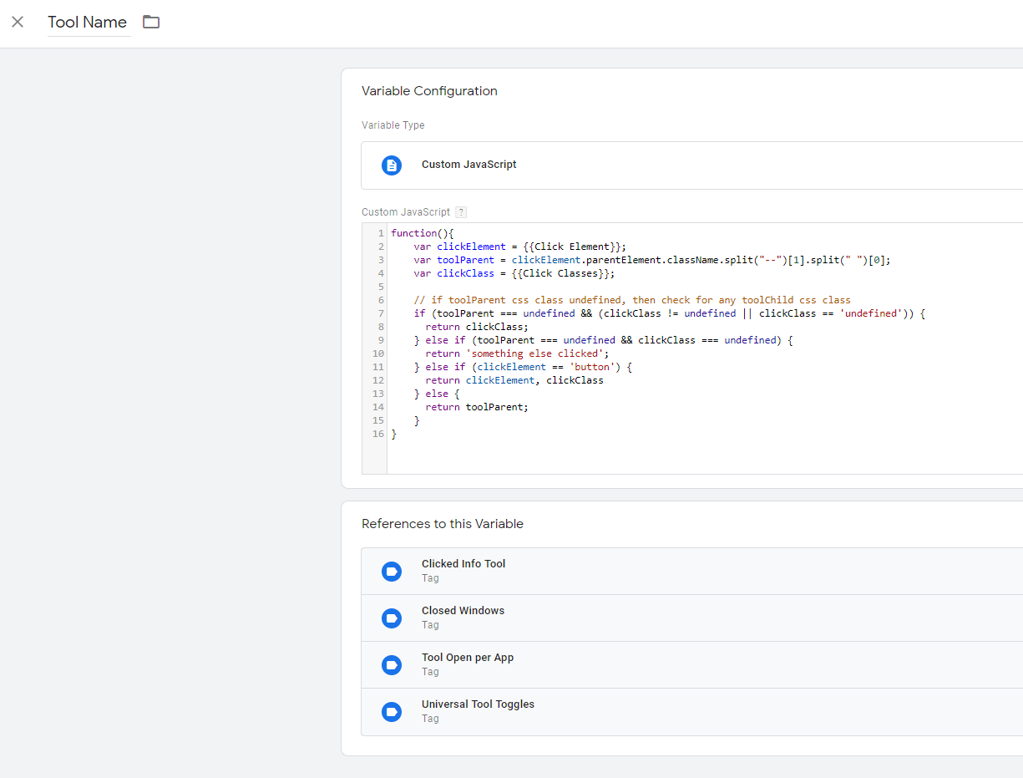
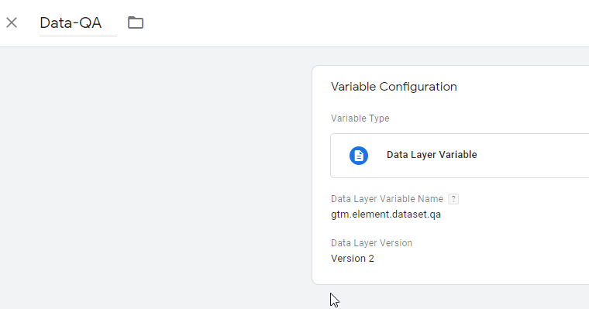
Set Variables
Notes:
Capture classes and places into variablkes

Slide 9
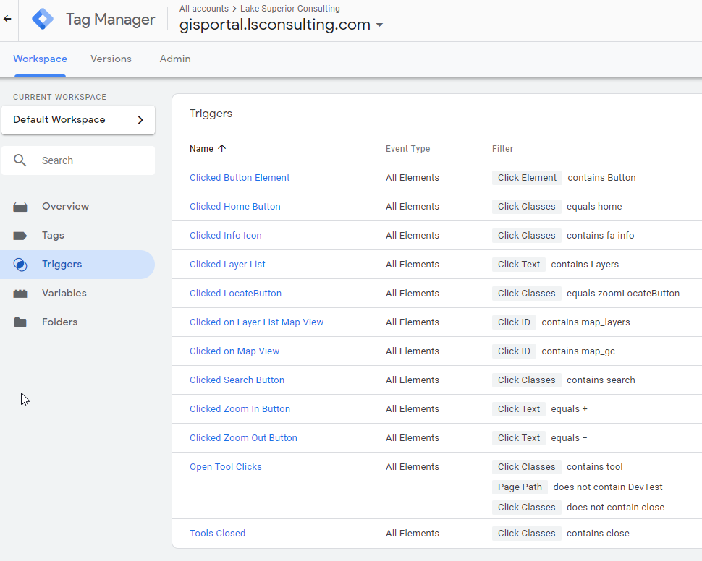
Set Triggers
Notes:
Captures clicks

Slide 10
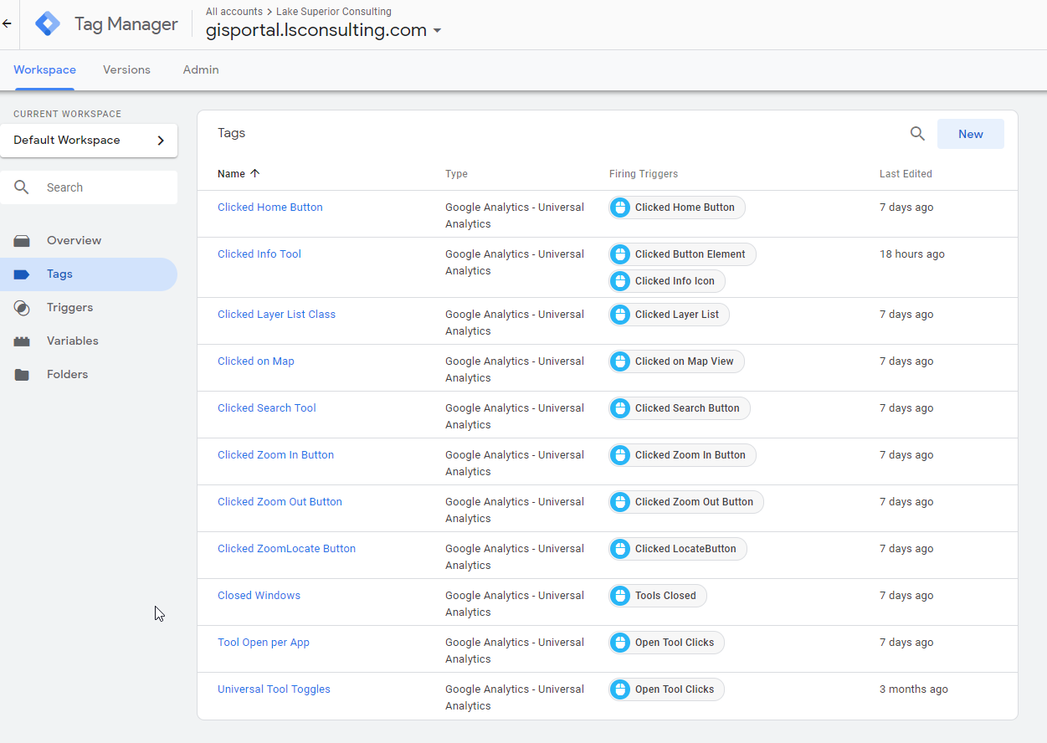
Set Tags

Slide 11
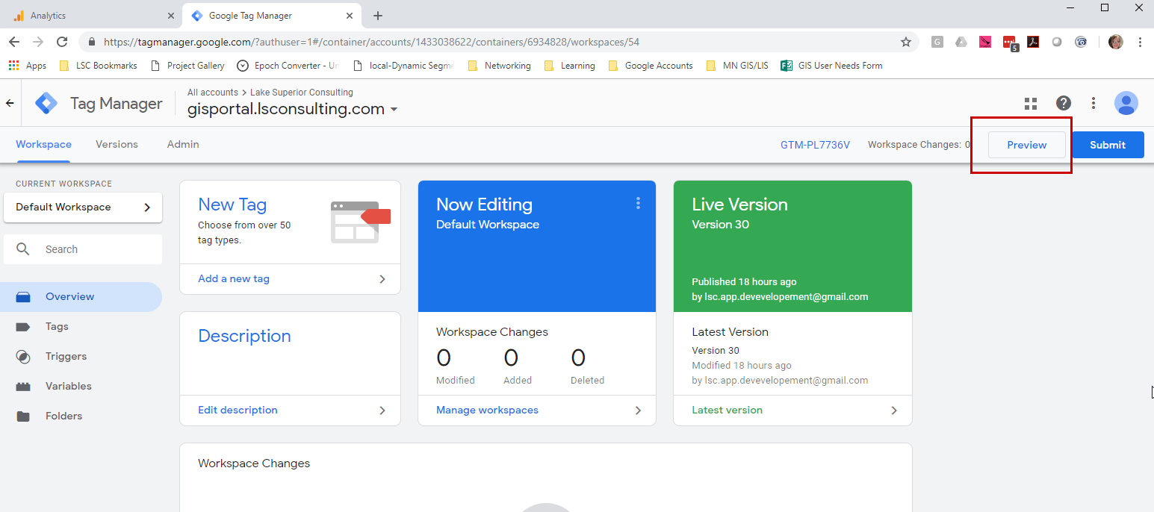
Test in Realtime Preview

